Slide 1
Explore API and ES6 methods

Slide 2
Application Programming Interface
-
API

Slide 3
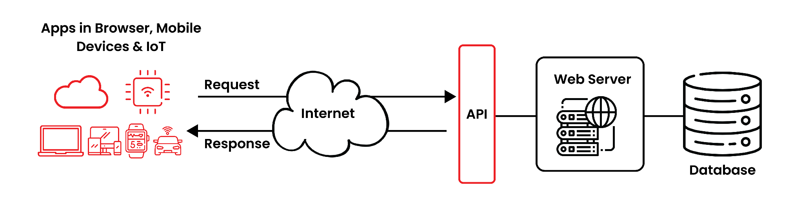
Application Programming Interface

Slide 4
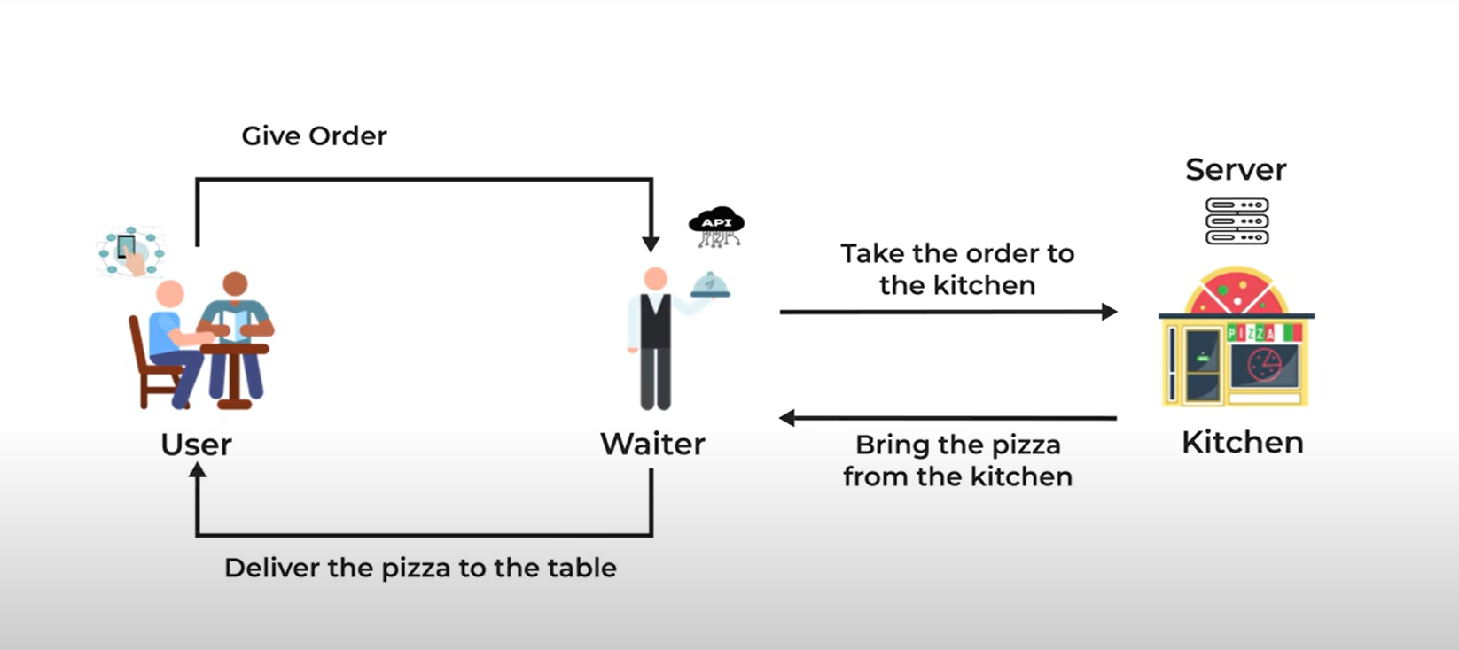
Application Programming Interface

Slide 5
Application Programming Interface
API is the acronym for Application Programming Interface, which is a software intermediary that allows two applications to talk to each other.
Types of APIs:
APIs by availability: Private, partner, public
APIs by use cases: Database APIs, OS APIs, Remote APIs, Web APIs.

Slide 6
JavaScript Object Notation - Introduction
-
JSON

Slide 7
JSON
JSON stands for JavaScript Object Notation
JSON is a text format for storing and transporting data
JSON is plain text written in JavaScript object notation
Why do we use JSON:
You can receive pure text from a server and use it as a JavaScript object.
You can send a JavaScript object to a server in pure text format.
You can work with data as JavaScript objects, with no complicated parsing and translations.

Slide 8
JSON
JSON Syntax:
The JSON syntax is a subset of the JavaScript object syntax.
A name/value pair consists of a field name (in double quotes), followed by a colon, followed by a value For example: {"key":"value"}
JSON names require double quotes.(*)

Slide 9
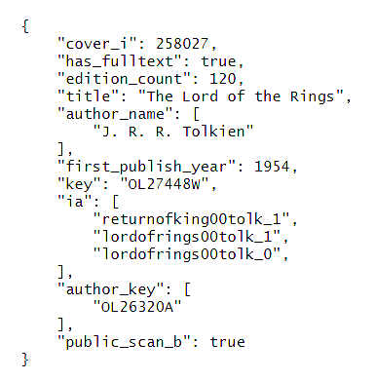
JSON
JSON Example:

Slide 10
JSON
JSON Methods:
JavaScript also has a built in function for converting an object into a JSON string:
JSON.stringify()
JavaScript has a built in function for converting JSON strings into JavaScript objects:
JSON.parse()

